Slide 1
Good Database Design
no redundancy of FACT
no inconsistency
no insertion, deletion or update anomalies
no information loss
no dependency loss

Slide 2
Data Redundancy
Major aim of relational database design is to group attributes into relations to minimize data redundancy and reduce file storage space required by base relations.
Problems associated with data redundancy are illustrated by comparing the following Staff and Branch relations with the StaffBranch relation.

Slide 3


Data Redundancy

Slide 4
Data Redundancy
StaffBranch relation has redundant data: details of a branch are repeated for every member of staff.
In contrast, branch information appears only once for each branch in Branch relation and only branchNo is repeated in Staff relation, to represent where each member of staff works.

Slide 5
Update Anomalies
Relations that contain redundant information may potentially suffer from update anomalies (abnormalities or irregularities which occure during updates).
Types of update anomalies include:
  Insertion
  Deletion
  Modification

Slide 6
Data Redundancy

Slide 7
Insertion Anomalies
New member of staff joins branch B005
  Insert new row into StaffBranch table
  Type wrong address: 163 Main St, glasgow.
  Database is now inconsistent!
Establish new branch with no members of staff
  B008, 57 Princes St, Edinburgh
  No staff members, so staffNo must be NULL
  But staffNo is the primary key of the StaffBranch table, so cannot be NULL!

Slide 8
Deletion Anomaly
Mary Howe, staffNo SA9, leaves the company
  Delete the appropriate row of StaffBranch
  This also deletes details of branch B007 where Mary Howe works
  But no-one else works at branch B007, so we no longer know the address of this branch!

Slide 9
Modification Anomaly
Branch B003 has transferred to a new location
  New address is 145 Main St, Glasgow
  Must change three rows of the StaffBranch relation

Slide 10
Functional Dependency
Formal Definition: Attribute B is functionally dependent upon attribute A (or a collection of attributes) if a value of A determines a single value of attribute B at any one time.
Formal Notation: A → B This should be read as ‘A determines B’ or ‘B is functionally dependent on A’. A is called the determinant and B is called the object of the determinant (or dependent).
Example:
Functional Dependencies
staffNo job dept dname
SL10 Salesman 10 Sales
SA51 Manager 20 Accounts
DS40 Clerk 20 Accounts
OS45 Clerk 30 Operations
staffNo → job
staffNo → dept
staffNo → dname
dept → dname
dname → dept

Slide 11
Full Functional Dependency
Full Functional Dependency: Only of relevance with composite determinants. This is the situation when it is necessary to use all the attributes of the composite determinant to identify its object uniquely.
Example:
order# Pd# qty price
A001 001 10 200
A002 001 20 400
A002 002 20 800
A004 001 15 300
Full Functional Dependencies
(Order#, Pd#) → qty
(Order#, Pd#) → price

Slide 12
Partial Functional Dependency
Partial Functional Dependency: A Partial Functional Dependency occurs when an attribute is dependent on only a part of a composite determinant.
Example:
Full Functional Dependency
Student# Crs# CrsName grade
(Student#, Crs#) → grade
Partial Functional Dependency
Crs# → CrsName

Slide 13
Transitive Functional Dependency
Transitive Functional Dependency: A transitive functional dependency exists when there is an intermediate functional dependency. In other words, if A → B and B → C, then A → C becomes a transitive dependency.
Example:
Transitive Functional Dependency
staffNo position branchNo branchAddress
staffNo→ brachNo
branchNo→ branchAddress
staffNo→ branchAddress
branchAddress is transitively dependent on staffNo
When non-key attribute depends on another non-key
attribute, its means that there is transitive dependency.

Slide 14
Normalization
Normalization is a formal process to decide which attributes should be grouped together to reduce redundancy.
It involves breaking down large tables into smaller ones and establishing relationships between them using primary keys and foreign keys. This ensures that data is stored efficiently and prevents anomalies.

Slide 15
Stages of Normalization
Unnormalized form
(UNF)
Remove repeating groups
First normal form
(1NF)
Remove partial dependencies
Second normal form
(2NF)
Remove transitive dependencies
Third normal form
(3NF)
The stages of Normalization are called Normal Forms
There are six Normal Forms; however, the third normal form
is considered the highest level necessary for most applications
so we will only be discussing the first three forms.

Slide 16
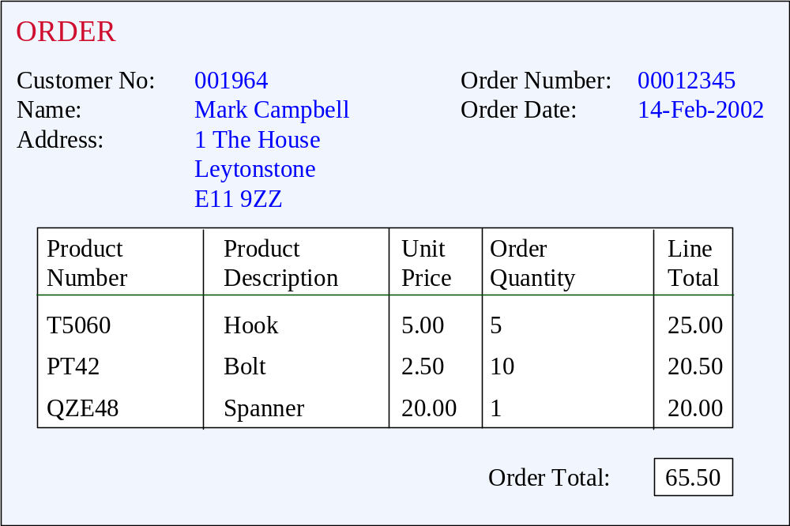
Unnormalized Form (UNF)
ORDER (order-no, order-date, cust-no, cust-name, cust-add,
(prod-no, prod-desc, unit-price, ord-qty, line-total)*, order-total

Slide 17
First Normal Form (1NF)
Definition: A relation is in 1NF if, and only if, all its underlying attributes contain atomic values only.
Remove repeating groups into a new relation
A repeating group is shown by a pair of brackets within the relational schema.
ORDER (order-no, order-date, cust-no, cust-name, cust-add,
(prod-no, prod-desc, unit-price, ord-qty, line-total)*, order-total

Slide 18
Steps from UNF to 1NF:
Remove the outermost repeating group (and any nested repeated groups it may contain) and create a new relation to contain it.
Add to this relation a copy of the PK of the relation immediately enclosing it.
Name the new entity (appending the number 1 to indicate 1NF)
Determine the PK of the new entity
Repeat steps until no more repeating groups.

Slide 19
Example - UNF to 1NF
ORDER (order-no, order-date, cust-no, cust-name, cust-add,
(prod-no, prod-desc, unit-price, ord-qty, line-total)*, order-total
1. Remove the outermost repeating group (and any nested repeated groups it may contain) and create a new relation to contain it. (rename original to indicate 1NF)
ORDER-1 (order-no, order-date, cust-no, cust-name, cust-add, order-total
(prod-no, prod-desc, unit-price, ord-qty, line-total)
2. Add to this relation a copy of the PK of the relation immediately enclosing it.
ORDER-1 (order-no, order-date, cust-no, cust-name, cust-add, order-total
(order-no, prod-no, prod-desc, unit-price, ord-qty, line-total)
3. Name the new entity (appending the number 1 to indicate 1NF)
ORDER-LINE-1 (order-no, prod-no, prod-desc, unit-price, ord-qty, line-total)
4. Determine the PK of the new entity
ORDER-LINE-1 (order-no, prod-no, prod-desc, unit-price, ord-qty, line-total)

Slide 20
Second Normal Form (2NF)
Definition: A relation is in 2NF if, and only if, it is in 1NF and every non-key attribute is fully dependent on the primary key.
Remove partial functional dependencies into a new relation

Slide 21
Steps from 1NF to 2NF:
Remove the offending attributes that are only partially functionally dependent on the composite key, and place them in a new relation.
Add to this relation a copy of the attribute(s) which are the determinants of these offending attributes. These will automatically become the primary key of this new relation.
Name the new entity (appending the number 2 to indicate 2NF)
Rename the original entity (ending with a 2 to indicate 2NF)

Slide 22
Example - 1NF to 2NF
ORDER-LINE-1 (order-no, prod-no, prod-desc, unit-price, ord-qty, line-total)
1. Remove the offending attributes that are only partially functionally dependent on the composite key, and place them in a new relation.
ORDER-LINE-1 (order-no, prod-no, ord-qty, line-total)
(prod-desc, unit-price)
2. Add to this relation a copy of the attribute(s) which determines these offending attributes. These will automatically become the primary key of this new relation..
ORDER-LINE-1 (order-no, prod-no, ord-qty, line-total)
(prod-no, prod-desc, unit-price)
3. Name the new entity (appending the number 2 to indicate 2NF)
PRODUCT-2 (prod-no, prod-desc, unit-price)
4. Rename the original entity (ending with a 2 to indicate 2NF)
ORDER-LINE-2 (order-no, prod-no, ord-qty, line-total)

Slide 23
Third Normal Form (3NF)
Definition: A relation is in 3NF if, and only if, it is in 2NF and every non-key attribute is non-transitively dependent on the primary key.
Remove transitive dependencies into a new relation

Slide 24
Steps from 2NF to 3NF:
Remove the offending attributes that are transitively dependent on non-key attribute(s), and place them in a new relation.
Add to this relation a copy of the attribute(s) which are the determinants of these offending attributes. These will automatically become the primary key of this new relation.
Name the new entity (appending the number 3 to indicate 3NF)
Rename the original entity (ending with a 3 to indicate 3NF)

Slide 25
Example - 2NF to 3NF
ORDER-2 (order-no, order-date, cust-no, cust-name, cust-add, order-total
1. Remove the offending attributes that are transitively dependent on key attributes and place them in a new relation.
ORDER-2 (order-no, order-date, cust-no, order-total
(cust-name, cust-add )
2. Add to this relation a copy of the attribute(s) which determines these offending attributes. These will automatically become the primary key of this new relation..
ORDER-2 (order-no, order-date, cust-no, order-total
(cust-no, cust-name, cust-add )
3. Name the new entity (appending the number 3 to indicate 3NF)
CUSTOMER-3 (cust-no, cust-name, cust-add )
4. Rename the original entity (ending with a 3 to indicate 3NF)
ORDER-3 (order-no, order-date, cust-no, order-total

Slide 26
Example - Relations in 3NF
ORDER-3 (order-no, order-date, cust-no, order-total
CUSTOMER-3 (cust-no, cust-name, cust-add )
PRODUCT-2 (prod-no, prod-desc, unit-price)
ORDER-LINE-2 (order-no, prod-no, ord-qty, line-total)
prod-no
order-no
PRODUCT
ORDER
places
contains
shows
placed by
belongs to
cust-no
order-no, prod-no
CUSTOMER
part of
ORDER-LINE

Slide 27
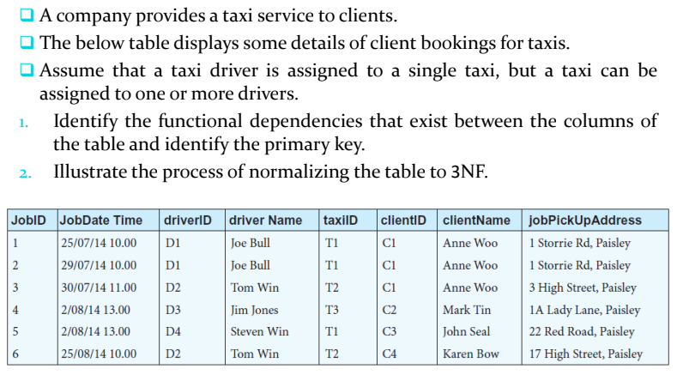
Exercise

Slide 28
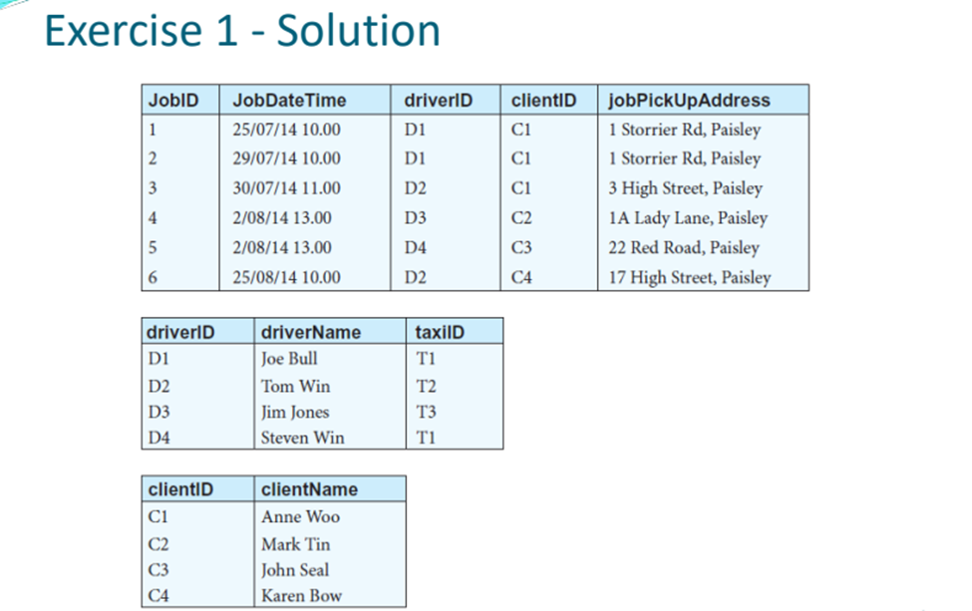
Solution

Slide 29

Exercise

